Slide 1
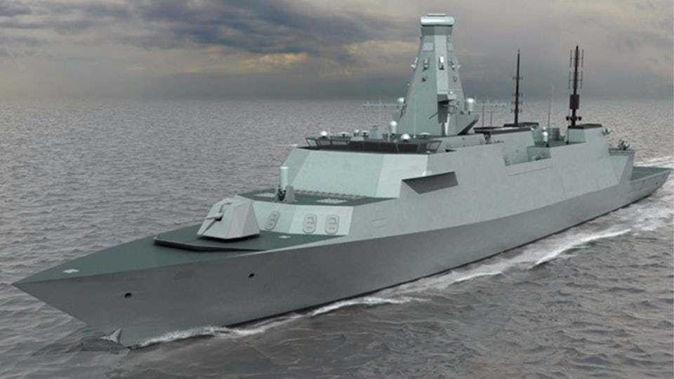
A Model(s)-Based
Approach to
PM-SE Integration
By
Kamran Shahroudi
kami@colostate.edu
Raymond Jonkers
ray.jonkers@merlantec.ca
Related Working Group:
MBSE Initiative; PM-SE Integration
28 January 2020

Slide 2
Purpose
Advance the field of PM-SE Integration
Describe and demonstrate a novel approach and practical integrated model for PM-SE integration
We have created a model-based PM-SE Integration Prototype called a “Management Flight Simulator”
Describe linkages within the prototype for effective PM-SE integration and collaboration
Provide a glimpse into hopefully not the very distant future where MBSE philosophy and tools can mature to support PM-SE Integration
Obtain validation in the approach and ability of the prototype to enhance PM-SE Integration

Slide 3
Introduction and Outline
Challenges with complex product and project management
Challenges with PM-SE Integration
Guidelines for PM-SE Integration
Novel approach to linking SE models and lifecycle management curves
Practical model and flight management simulator for PM-SEI based on an integrated power system (non-toy application)
Return on investment using approach, model and simulator
Need to validate framework and approach by getting Q&A feedback from a broader set of PM & SE Experts
Award Winning Paper IEEE SysCon:
“Reducing the Costs of Engineering Design Changes Through Adoption of a
Decision Support and Knowledge Management System Early in the Design”
Link to Article: https://ieeexplore.ieee.org/document/8836740
Kamran Eftekihari Shahroudi
Principal SE and Manager
Woodward Inc.
Raymond Jonkers
CSU PhD Candidate

Slide 4
Challenges with Complex Product and Project Management
Continued Product and Project Failures:
Over 60% of complex projects experience cost overruns and delays¹
Organizational and project dynamics have not been understood until it is too late¹
Design Changes and New Technology:
Misinterpretation, inconsistent, unstable requirements and specifications
Increased number of design changes and just-in-time technology for defense projects
Late design changes cost 80X by CDR²
Rework and changes can consume 30% to 70% of design effort³
Changes can consume up to 70% of production capacity⁴
Two thirds of all design changes could be prevented by better communication and integration⁴
Warship program cost overruns and delays attributed to new technology and integration issues⁵
Increased System and Project complexity (ambiguity and uncertainty)
Reactive fire-fighting and lack of proactive risk management¹
Increased amount of information, 20% of designers’ time is spent searching for information⁶
60% to 80% lifecycle costs committed by PDR with lack of knowledge⁶
Poor program management, performance management, acquisition and contracting practices ¹
Notes:
Rebentisch
Ranky
Kennedy
Inayat
Lombardi and Park
Verhagen and Smith

Slide 5
Challenges with PM-SE Integration
Only 16% of organizations are fully integrated¹
Several disparate practices, processes and standards (SEBoK, PMBoK, BABoK, EMBoK)
Different engineer versus corporate management values and loyalty
Unproductive tension between PM and SE disciplines that extends to other disciplines
Theoretical PM-SE integration guidelines but no practical integrated model to help bring disciplines together
Siloed use of discipline specific models and tools, need to utilize broad knowledge base
Techno-socio-economic and cultural factors not captured in decision models
Some models aimed at integration but no universal fit for all programs
Several design models do not capture aspects of time and social sciences²
Very low percentage of high-technology organizations utilize MBSE and SE models³
Misalignment of enterprise, culture, competency, knowledge, and non-integrated processes¹
Notes:
Integrating Program Management and Systems Engineering, Rebentisch Eric
Engineering Systems Multiple Domain Matrix: An Organizing Framework for Modeling Large-Scale Complex Systems, Bartolomel
MBSE: The Next Revolution of Systems Engineering, virtual classroom presentation, MIT, Cameron B

Slide 6
PM-SE and Management System Integration Guidelines
Benefits of MBSE¹ | Senge’s Principles of a Learning Organization² | Key Practices for an Integrated Management System³ | Integrated Product and Process Development Features⁴ | Dimensions of PM-SE Integration⁵
Communications | Systems Thinking | Infrastructure to Support Vision | Team Collaboration | Processes, Practices and Tools
Knowledge | Personal Mastery | Cultivate Knowledge | Early Knowledge | Environment: Leadership, Knowledge and Culture
Learning Systems Engineering | Team Learning | Learning and Social Networking | Optimization of Decisions | People Competencies: Learning and Communication
Perspectives and Managing Complexity | Mental Models | Integration of Useful Information | Simulation of Information | Contextual Factors: Program, Organization and Team Characteristics
Product Quality | Shared Vision | Continuous Improvement | Early Design Analysis | Program Performance
Notes:
INCOSE SE Handbook V4 (para 9.2)
The Fifth Discipline – The Art and Practice of the Learning Organization, Peter Senge
Integrated Management Systems, Lee
Dynamics of Naval Ship Design: A Systems Approach, Laverghetta
Integrating Program Management and Systems Engineering, Rebentisch
Common themes for project success include a learning culture, procurement and material information, relational subcontractor management, collaboration and teaming, risk management, and a focus by all on shared high-level outcomes and benefits.

Slide 7
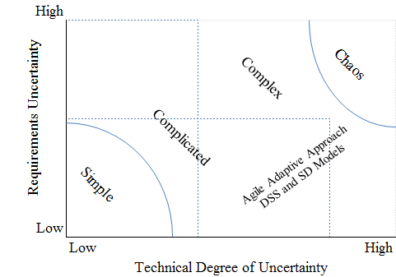
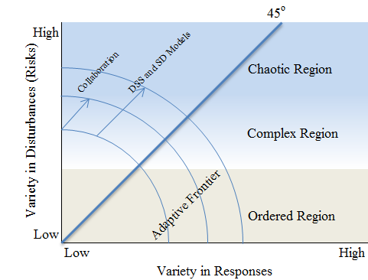
Elements of the Solution to PM-SE Integration
14% program development costs for SE effort optimal for project success¹ (adopt a different commitments spend curve)
Opportunity to adopt set-based design and agile approaches through use of an integrated model and simulator
A Decision Support System (DSS) and System Dynamics (SD) model that form the Management Flight Simulator
to help navigate the Stacey Complexity Model and Ashby’s Space
to integrate PM and SE
Leverage
efficacy of exiting SE models and use a structured systems thinking approach to integrate models
lessons-learned and recurring themes from past project failures and successes (the techno-socio-economic and cultural factors)
existing Integration guidelines
Stacey Complexity Model
Ashby’s Space
Notes:
Set-based design has been reported as effective in improving design robustness and in reducing rework (Kennedy 2013).
In a PMI survey, more than half of organizations expressed doubt in managing complexity (Cooke-Davies 2013). In the same survey, ambiguity in expectations and managing multiple stakeholders were rated as top defining characteristics of complexity.

Slide 8
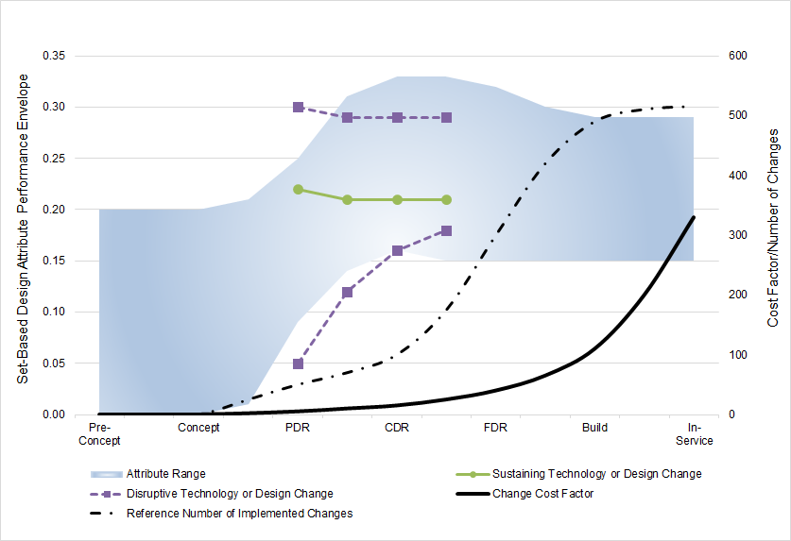
System State, Set-Based Design, Changes and New Technology
Notes:
Provenance for the DSS sub-model

Slide 9
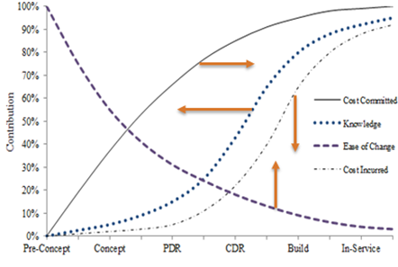
Influencing The Lifecycle Management Curves

Slide 10
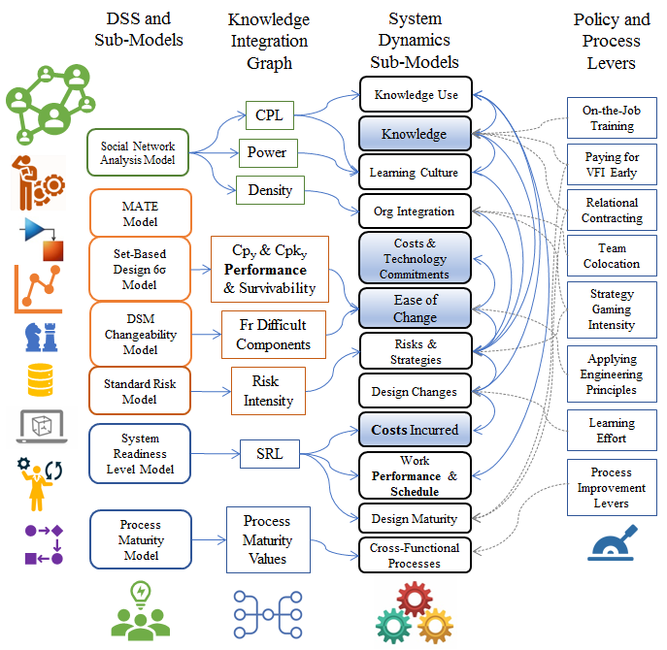
Exploring Linkages for PM-SE Integration
Notes:
system state and adjusted levers

Slide 11
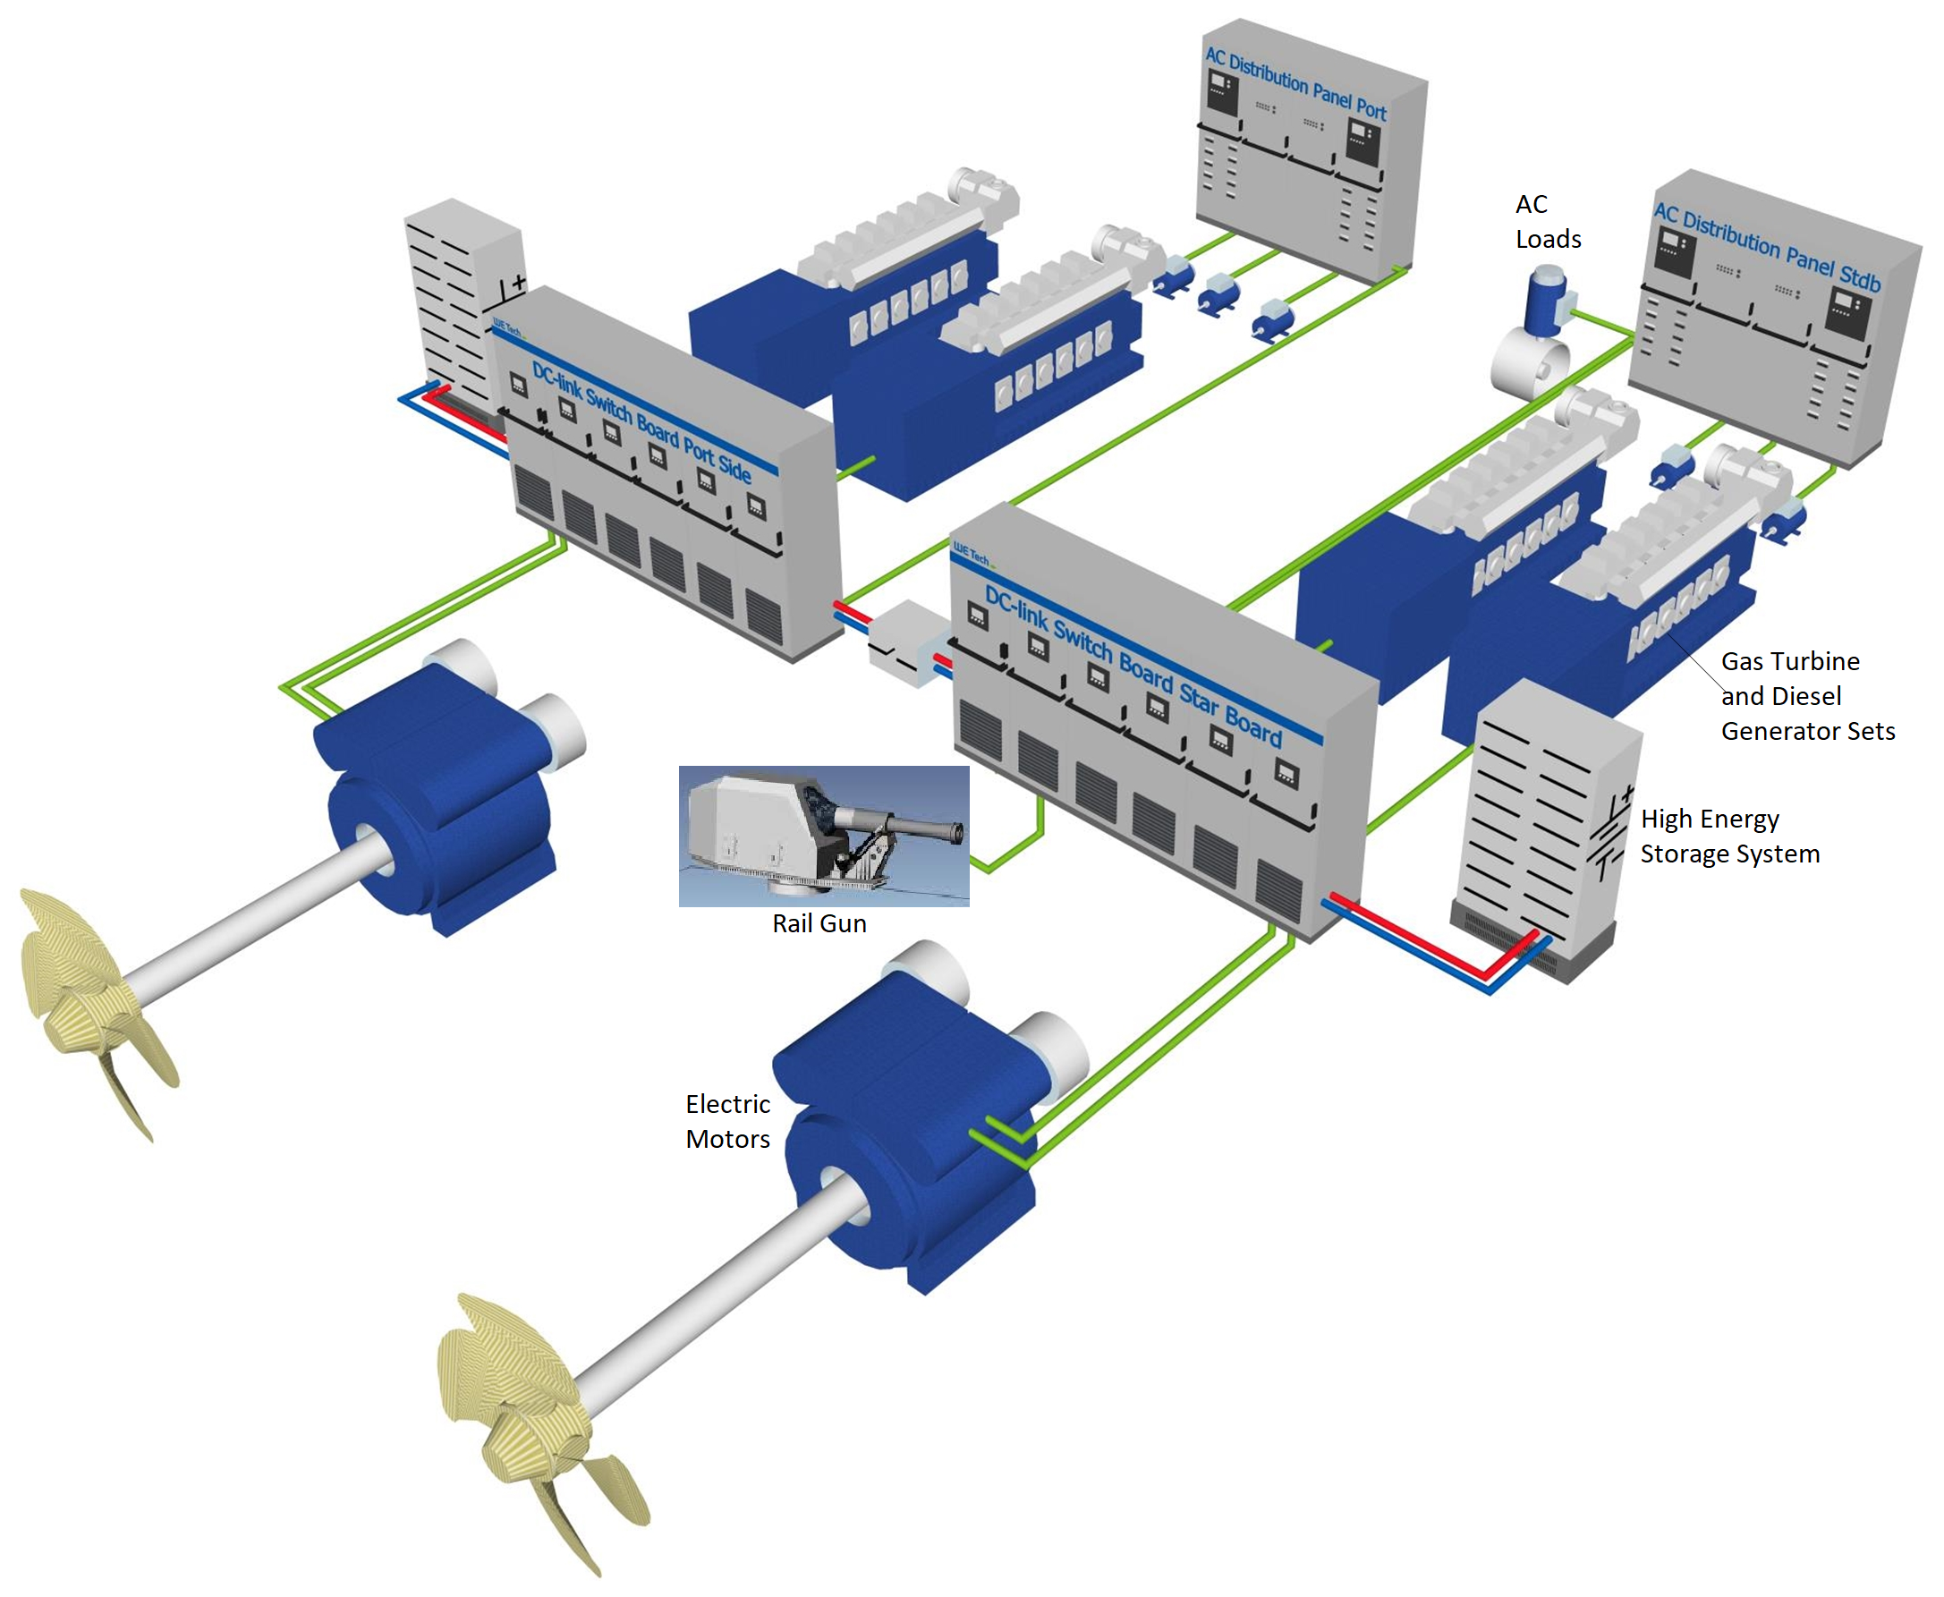
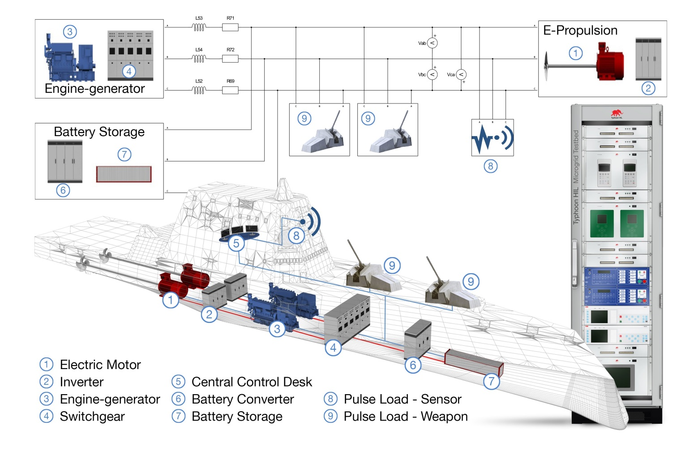
Case Study: Marine Integrated Power System (IPS)
Complex integrated design with advanced technology
Need PM-SE integration to manage
Notes:
The case study is an advanced warship IPS, a complex system.
Two 15 MW GT’s, two 3 MW DG’s, 320 MJ HESS, and an advanced PMS

Slide 12
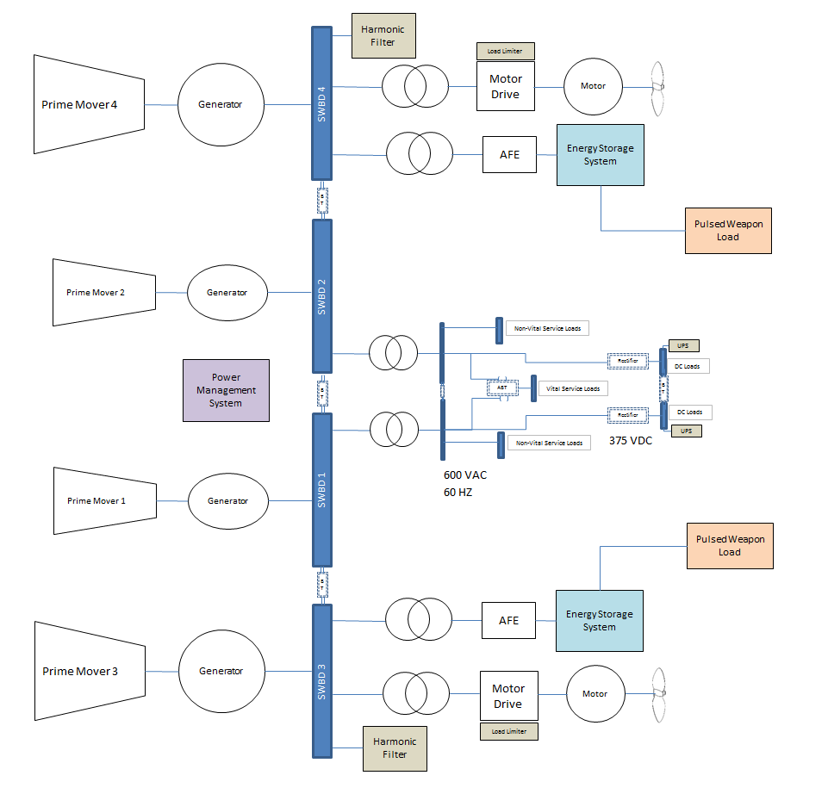
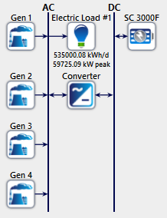
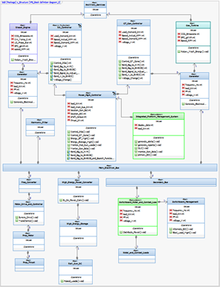
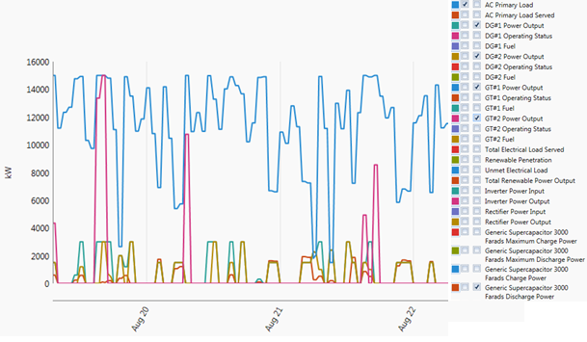
Case Study: Marine Integrated Power System (IPS)
MBSE and IPS Optimization Models
Notes:
MBSE and Other models to describe the IPS.
Optimization of IPS through engineering models (MatLab, Homer, Commercial Specific) – for updating the DSS and for Attribute Management.

Slide 13
Model Benefits:
Structured Recipe of Linked Models forming a Management Flight Simulator that brings PM-SE together on a common platform, using a common language, providing awareness of how system state impacts lifecycle management curves, and providing the ability to predict and influence system, project and organization behavior. Use of this model will address challenges in complex product and project management and in PM-SE integration; it will:
Improve communications and collaboration
Enhance early knowledge, learning and provide mental models
Proactively address risks and provide a risk management culture
Gain industry interest, promote and exploit SE and the Management Flight Simulator as a common view and application across all disciplines
Provide different perspectives in effectively managing system and project complexity
Enhance tradeoff analysis, early design analysis and identification of problems and optimize decisions
Improve product quality through early knowledge, increased ease-of-change, VFI maturity, set-based design and reduced rework, and maintenance of design integrity
Improve project performance (reduced design change costs and schedule delays)
Holistically address techno-socio-economic and cultural factors, and interrelationships (project and organizational dynamics)
Help organizations grow and evolve in the right direction over the design lifecycle

Slide 14
Demo of Flight Management Simulator

Slide 15
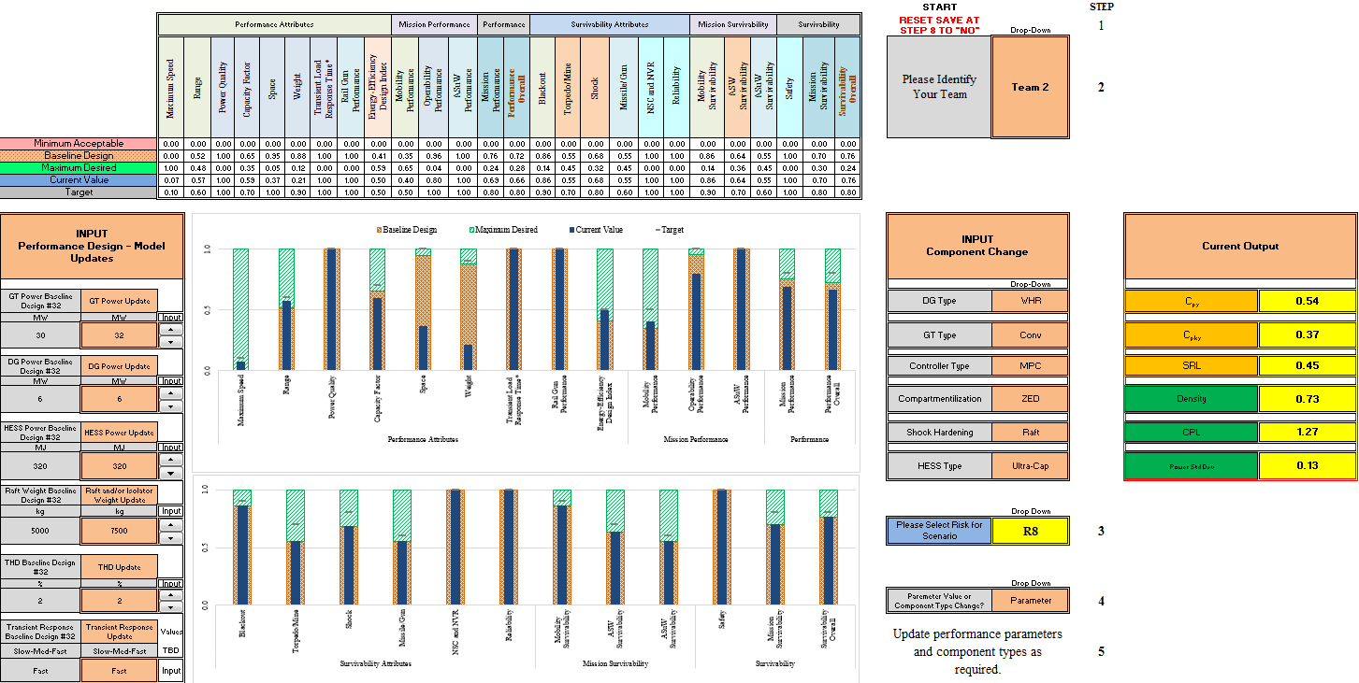
Management Flight Simulator DSS Demo
Notes:
The DSS provides a list of payoffs for decision-making and characterization of a new value space for design change and project management.
It consists of Attribute Management, Risk Management and Component Changeability Management sections; all linked.
Output of DSS and SNA. SRL and PMM sub models provides input into the SD Model Management Curves.
Different Perspectives, tradeoff analysis, early knowledge and enhanced decision-making

Slide 16
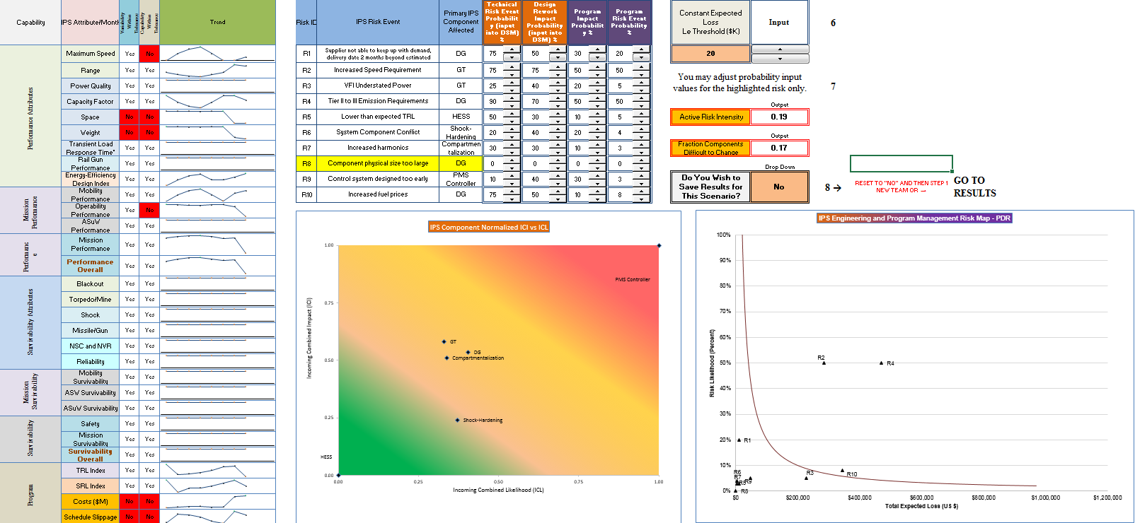
Management Flight Simulator DSS Demo

Slide 17
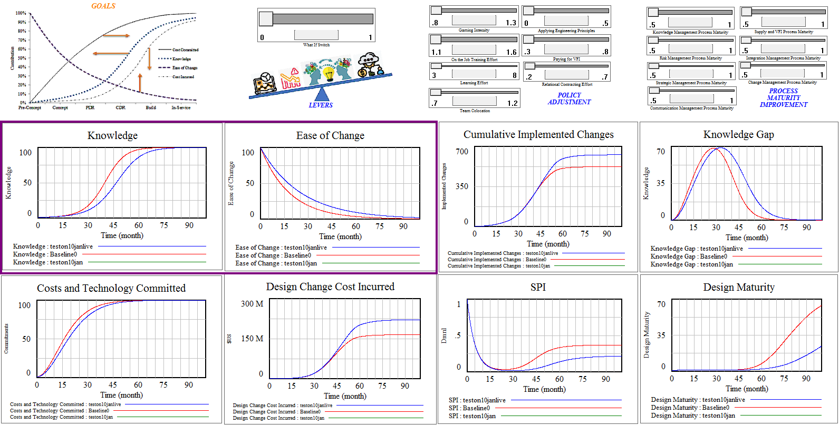
Management Flight Simulator SD Model Demo
Notes:
It also includes interactive system, process and policy levers that may be adjusted to improve performance. With adjustment to a few levers, knowledge can be gained early in design and system ease of change increased, leading to reduced design change costs and schedule delays. Other management curves positively influenced by adjusted levers include the number of design changes, design maturity, schedule performance, and the knowledge gap.
The adjustment of system, policy and process levers and the corresponding change in system attributes and management curves intuitively made sense. This was validated through the application of the case study, change scenarios and through interviews with industry experts.

Slide 18
Survey Questionnaire

Slide 19
Validation Questions
How do you rate (Low 1 to High 5) the potential of the Management Flight Simulator to:
improve Communication and Collaboration?
increase early Knowledge, Learning and provide Mental Models?
proactively address risks and promote a Risk Management culture?
promote learning and application of Systems Engineering and its models?
provide different Perspectives for addressing Complexity?
enhance Tradeoff Analysis and Optimize design change Decisions?
increase Product Quality?
improve Project Performance and foster Continuous Improvement?
address techno-socio-economic and cultural factors?
represent real world systems, predict and analyze behavior?
advance the field of Systems Engineering and Project Management integration?
How do you rate the need to include higher level product information such as performance, survivability and program attributes and the impact on management curves due to product design changes? (Low 1 to High 5)
Notes:
2. Honor

Slide 20
Key Take-Aways
Disciplines get appreciation of each other’s concerns and gain different perspectives
Knowledge and Ease-of-Change are key management curves
Use of tool can get to a smarter design and smarter people
Use of the tool can help navigate complexity, leading to product and project success
What-If scenarios and impacts can be better understood before acting
Can compare predictions to real data and adjust
There is value in a systems thinking approach to linking models and information, and understanding the “Why”
With PM-SE Integration challenges, not easy to promote approach and tool, but it can be worth it

Slide 22
